Slide 1
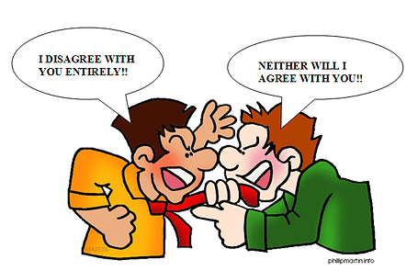
Expressing agreement or disagreement
Unit 3

Slide 2
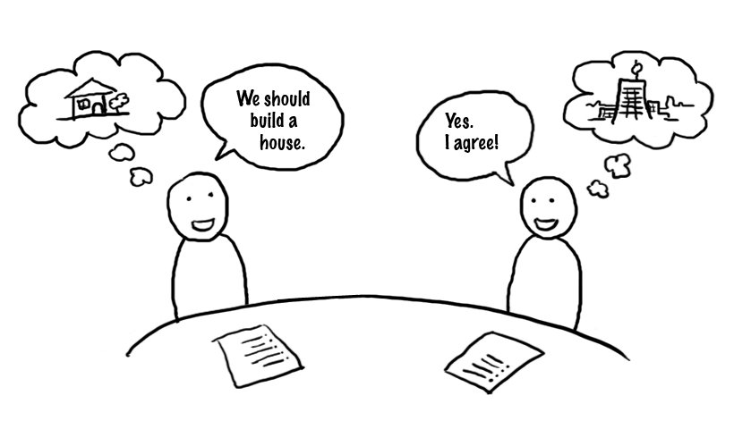
EXPRESSING AGREEMENT AND DISAGREEMENT
WHAT IS TO AGREE OR DISAGREE WITH SOMETHING?
To express what you THINK.
To say what you WANT TO SAY.
To agree with someone about
certain topics or situations.

Slide 3
SOME EXPRESSIONS OF AGREEMENT
That’s a good point
You have a point there
I feel the same way
I think so too
Absolutely
I totally agree
You’re right
I couldn’t agree more
Do you know any other expressions to express agreement?

Slide 4
VIDEO GAMES MAKES YOU SMARTER?
try to agree with this

Slide 5
EXPRESSING DISAGREEMENT
I totally disagree
I’m sorry to disagree but…
I hate to disagree but…
I’m afraid I have to disagre
I don’t think so
You’re wrong!
No way!
Isn’t true that….?
Don’t you think that…?
Do you know any other expressions to express disagreement?

Slide 6
DO YOU THINK ENGLISH IS BORING?
Try to disagree with this statement

Slide 7
PARTLY AGREE
I’m not so sure but…
I see your point but…
I partly agree…
Maybe, but…

Slide 8
SOME OTHER EXPRESSIONS
You also can begin a sentence expressing agreement or disagreent with these expressions;
I feel…
In my opinion…
I think…
I don’t think…
Well, yes, but…

Slide 9
TIPS
THE VERB ‘TO AGREE’
YES
NO

Slide 10
TASK
In no more than 3 students, create a dialogue using at least 4 expressions of agreement, partly agreement or disagreement.
Every student has to participate in the dialogue a minimum of 3 times.
You have only 30 minutes.
Use your imagination to create it and make your presentation unique.
You will have to present it in front of the class.
It will be graded.

